Slide 1


Introduction to Julia
JuliaCon 2024
Matt Bauman (mbauman)

Slide 2

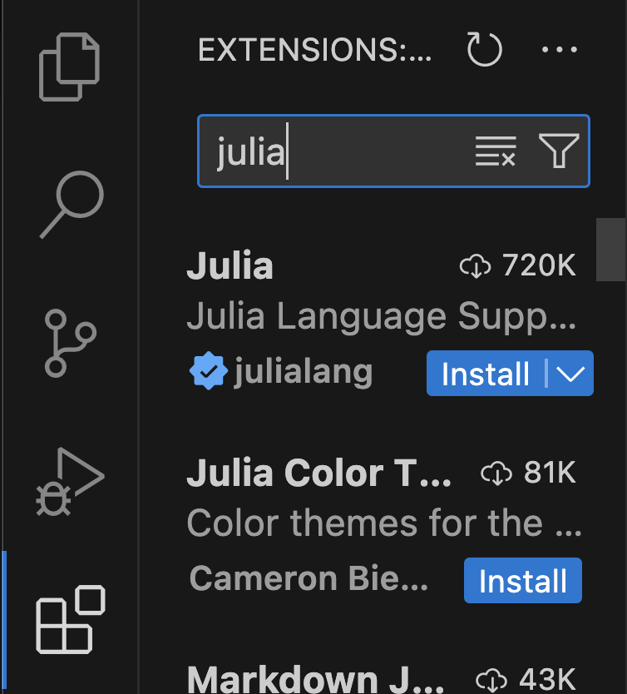

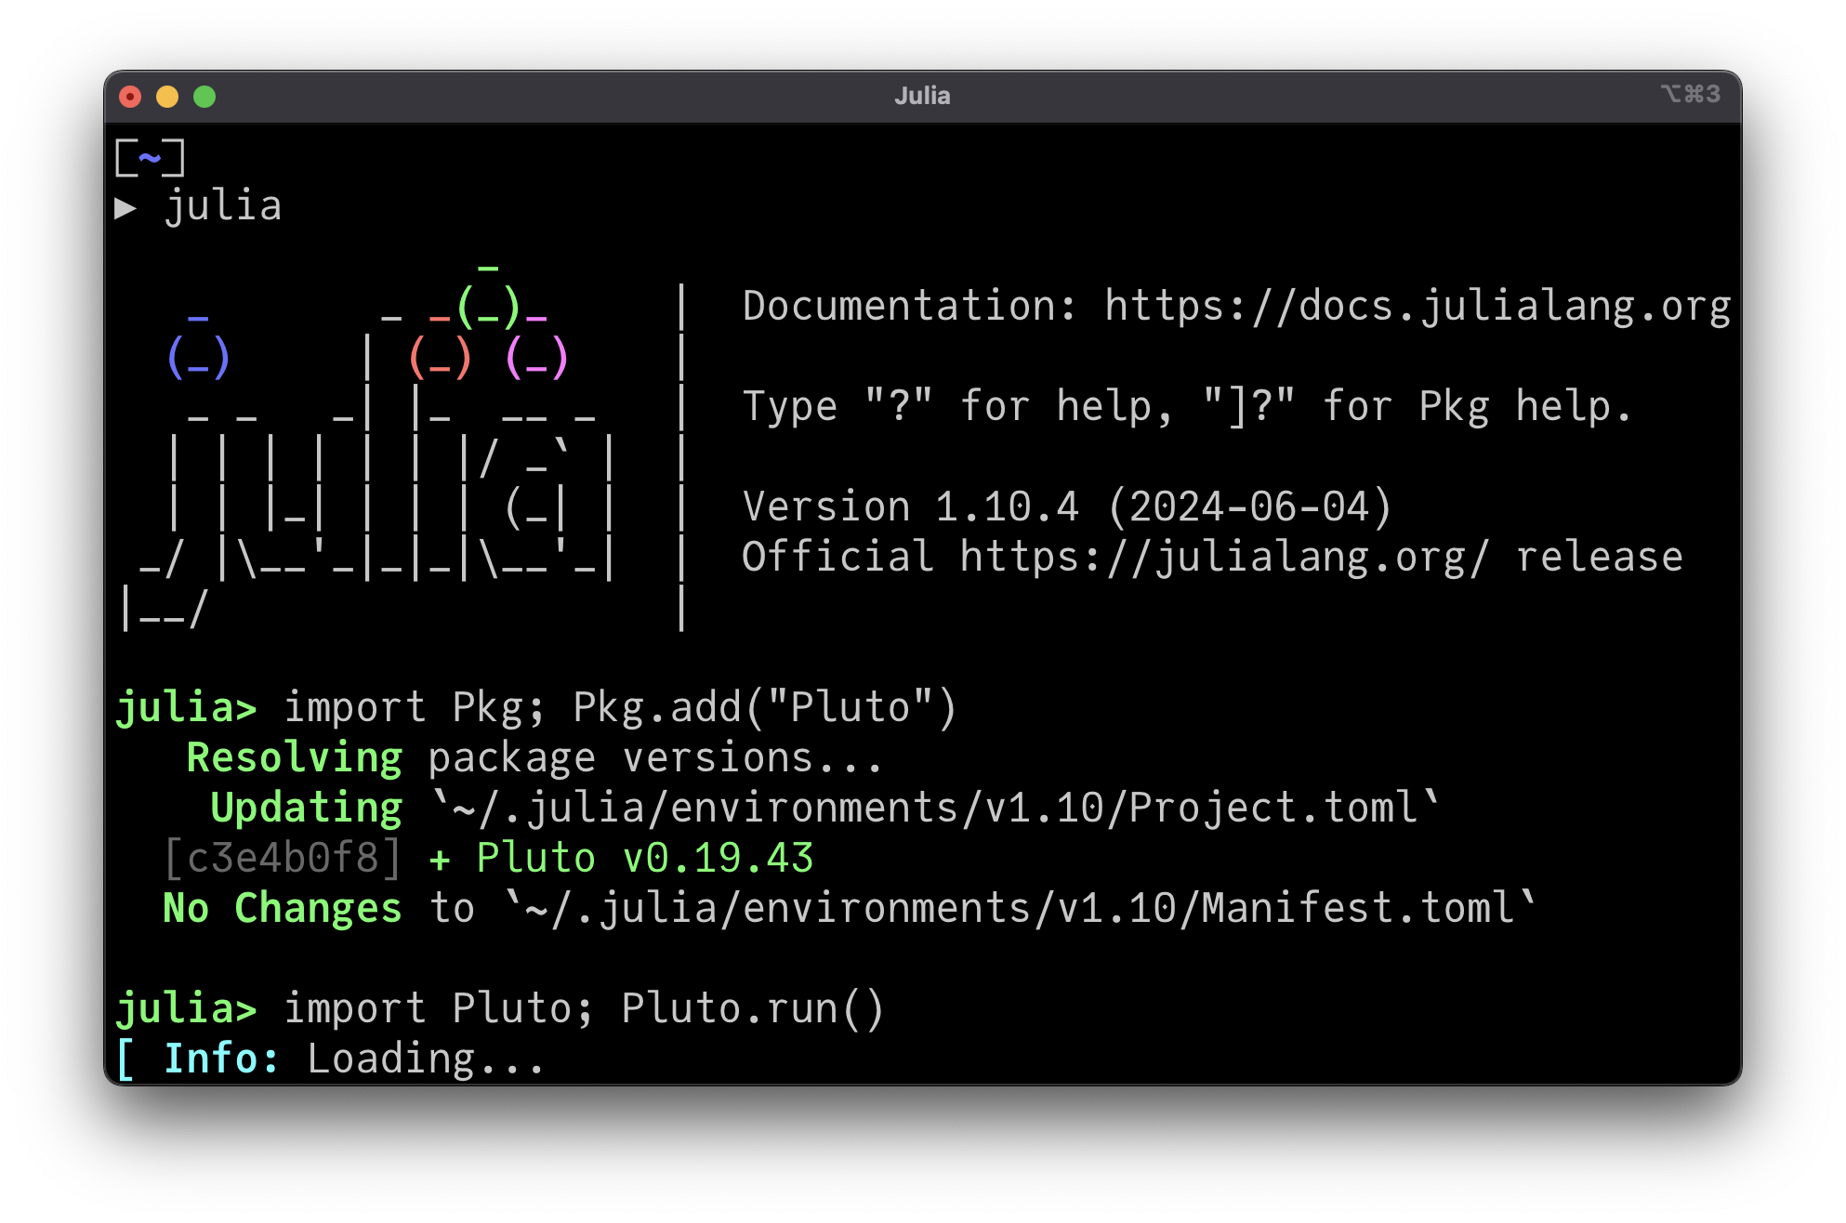

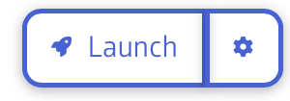
Welcome!
Install Julia, VS Code, and start Pluto
julialang.org
code.visualstudio.com
OR juliahub.com

Slide 3
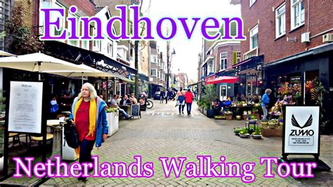
What’s the goal today?
Get to know the language by doing
Focus on mental models
Think of this workshop like a city walking tour
Walking tour rules apply!

Slide 4

Today’s path:
Start in Pluto (did you get it running?)
Julia as a calculator
Naming things: assignments
Creating functions and methods
Changing things: mutation!
Adding control flow
Arrays and plotting
Broadcasting, colors, and images
Benchmarks, data, and more plotting
Exercise!
Back to VS Code
Environments, packages, and workflows
Dashboards and deployment
10:30

Slide 5
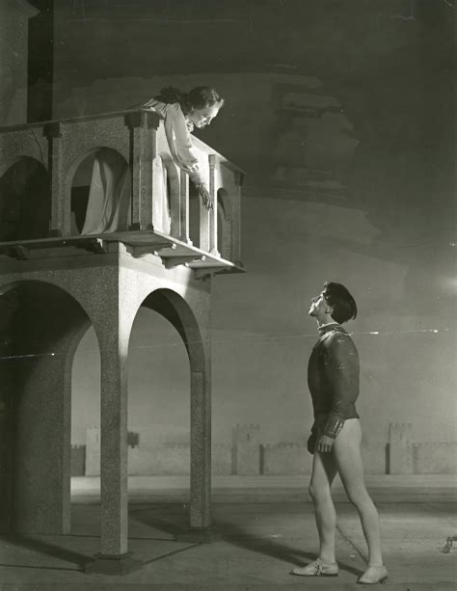
Naming
Gave names to numbers
The names we choose to use for things (and what we choose to use them for) can change
Pluto reactively re-evaluates cells!
Everything has a name or can have a name
The names are for us humans!
conventions: x, y, i, j, A, X, f, g, T, …
(Forget pointers, forget boxes, forget even the word "variable", I don’t even like nametags)

Slide 6
Functions
Have their own context for names (scope)
Have a name themselves, and can be renamed and passed about
Are called with arguments… what is actually passed?
Have zero or many methods
Each method may have different numbers of positional arguments
Optional positional arguments are just multiple methods
Each method may or may not support keyword (named) args

Slide 7
Today’s path:
Start in Pluto
Julia as a calculator
Naming things: assignments
Creating functions and methods
Changing things: mutation!
Adding control flow
Arrays and plotting
Broadcasting, colors, and images
Benchmarks, data, and more plotting
Exercise!
Back to VS Code
Environments, packages, and workflows
Dashboards and deployment

Slide 8
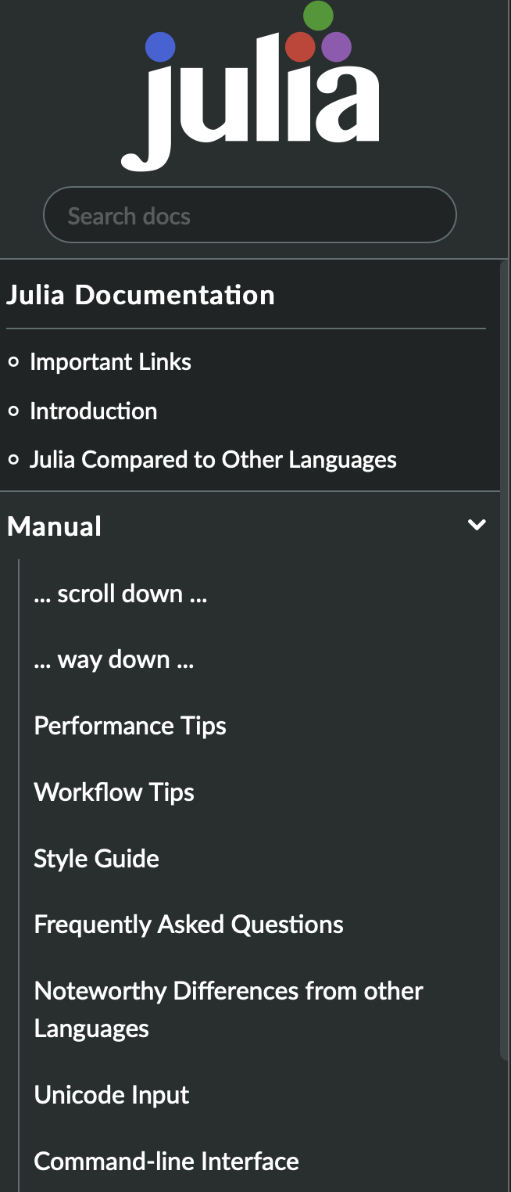

More resources
julialang.org
Community resources — discourse, slack, etc
docs.julialang.org
Large language models
JuliaHub’s “Ask AI” adds lots of Julia context
This is the good stuff

